Slide 1
MODULE 6

Slide 2
The Study of Microbial Growth
Growth takes place on two levels
Cell synthesizes new cell components and increases in size
The number of cells in the population increases
The Basis of Population Growth: Binary Fission

Slide 3
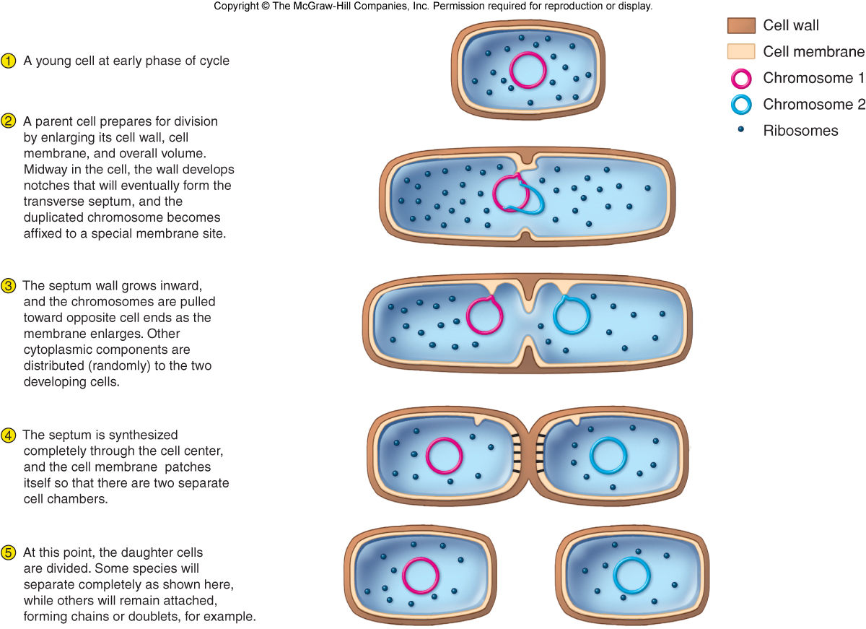

Slide 4
The Rate of Population Growth
Generation or doubling time: The time required for a complete fission cycle during the log stage. It is expressed in units of minutes.
Each new fission cycle or generation increases the population by a factor of 2
As long as the environment is favorable, the doubling effect continues at a constant rate
The length of the generation time- a measure of the growth rate of an organism
Average generation time- 30 to 60 minutes under optimum conditions
Can be as short as 10 to 12 minutes
E.g.: Escherichia coli (E. coli) double every 20 minutes
E.g.: Mycobacterium tuberculosis double every 12 to 24 hours
This growth pattern is termed exponential
Mean Growth rate (min⁻¹) =

Slide 5
Principles of Bacterial Growth
Growth can be calculated
N_{t} = N₀ x 2^{n}
(N_{t} ) number of cells in population
(N₀ ) original number of cells in the population
(n) number of divisions
Example
N₀ = 10 cells in original population
n = 12
4 hours assuming 20 minute generation time
N_{t} = 10 x 2¹²
N_{t} = 10 x 4,096
N_{t} = 40,960
mean growth rate constant (k) or number of generation per unit time=

Slide 6
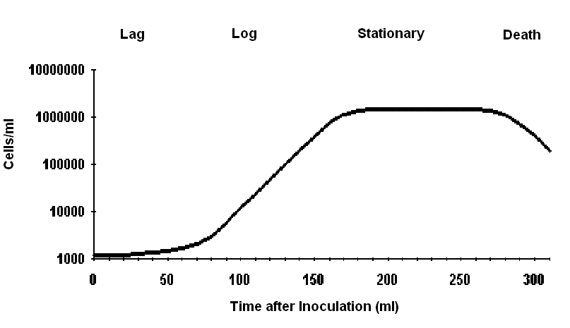
Phases of Growth in Batch Culture
Basic phases of growth:
1. Lag phase: new growth medium, period of delay while cells prepare to divide
2. Log phase (exponential growth phase): cellular reproduction most active during this period, generation time reaches a constant minimum
3. Stationary phase: state of equilibrium where number of cell deaths equals number of cell divisions

Slide 7
Phases of Growth
Basic phases of growth:
4. Rapidly Declining Death phase : cells die logarithmically, endospores formed, number of deaths exceeds number of new cells

Slide 8
Potential Importance of the Growth Curve
Implications in microbial control, infection, food microbiology, and culture technology
Growth patterns in microorganisms can account for the stages of infection
Understanding the stages of cell growth is crucial for working with cultures
In some applications, closed batch culturing is inefficient, and instead, must use a chemostat or continuous culture system

Slide 9
Graphing Bacterial Growth
The data from growing bacterial populations are graphed by plotting the number of cells as a function of time
If plotted logarithmically- a straight line
If plotted arithmetically- a constantly curved slope
To calculate the size of a population over time: N_{f} = (N_{i})2^{n} …..……(Population Equation)
N_{f} is the total number of cells in the population at some point in the growth phase
N_{i} is the starting number
n denotes the generation number
Mean generation time can be determined directly from a semilog plot of bacterial concentration vs time after inoculation

Slide 10
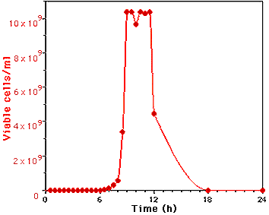
Calculation of Generation Time
Because of the very large differences in the number of cells present at the peak and at the start/end of the experiment, it's hard to see what's going on from this graph.
It's much easier to see the whole experiment if you plot the number of viable cells on a logarithmic scale (or more simply, plot the log of cell number).

Slide 11
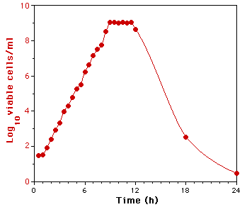
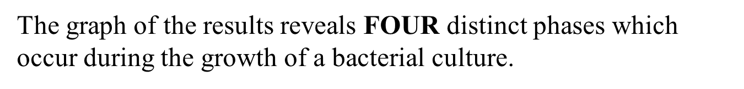
Calculation of Generation Time
the log plot

Slide 12
Calculation of Generation Time
When growing exponentially by binary fission, the increase in a bacterial population is by geometric progression. If we start with one cell, when it divides, there are 2 cells in the first generation, 4 cells in the second generation, 8 cells in the third generation, and so on. The generation time is the time interval required for the cells (or population) to divide.
B = number of bacteria at the beginning of a time interval
b = number of bacteria at the end of the time interval
G = t 3.3 log b/B

Slide 13
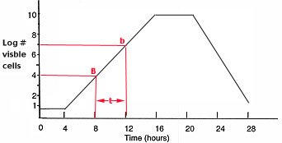
Calculation of Generation Time
Example: What is the generation time of a bacterial population that increases from 10,000 cells to 10,000,000 cells in four hours of growth?
G = t_____ 3.3 log b/B
G = 240 minutes 3.3 log 107/104
G = 240 minutes 3.3 x 3
G = 24 minutes

Slide 14
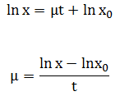
As explained by Loyola-Vargas and V á zquez-Flota (2006), the specific growth rate (µ) refers to the steepness of a curve, and it is defined as the rate of increase of biomass of a cell population per unit of biomass concentration. It can be calculated in batch cultures, since during a defined period of time, the rate of increase in biomass per unit of biomass concentration is constant and measurable. This period of time occurs between the lag phase and stationary phases. During this period, the increase in the cell population fits a straight-line equation between ln x and t.
Where, xo is the initial biomass (or cell density), x is the biomass (or cell density) at time t, and µ is the specific growth rate. Mu can be calculated from the above relationship, which is the slope of the line between ln x and t.

Slide 15

Doubling time
Doubling time (td) is the time required for the concentration of biomass of a population of suspension cells to double. One of the greatest contrasts between the growths of cultured plant cells refers to their respective growth rates. The doubling time (dt) can be calculated according to the following equation (Loyola-Vargas and V á zquez-Flota, 2006)

Slide 16
Methods for the growing unicellular organisms
Batch fermentation.
Fed-batch fermentation.
Continuous fermentation.

Slide 17
Batch fermentation
Considered to be a closed system.
The sterilized media in the fermenter is
inoculated with the microorganism.
Incubation is allowed under the optimum
conditions (aeration, agitation,
temperature).
During entire fermentation nothing is
added except air, antifoam and acid/base.

Slide 18
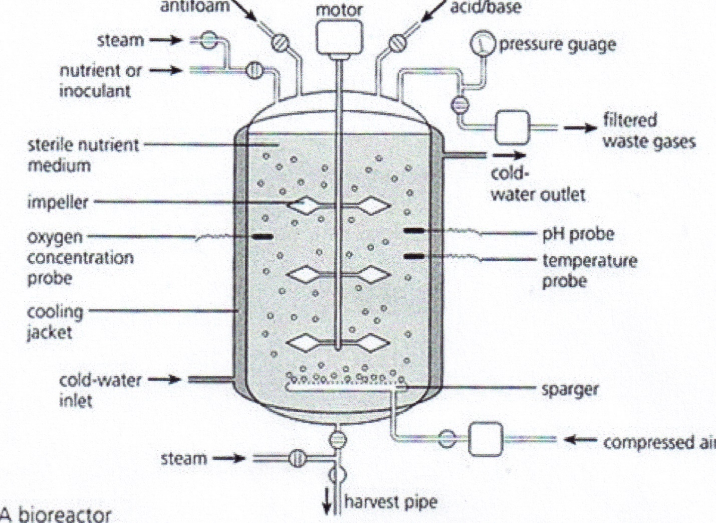
Batch fermenter system

Slide 19
Fed-Batch fermentation
It is enhancement of batch fermentation.
Continue adding the nutrients (feeding) in a
small doses during the fermentation.
The method in controlling nutrients feeding
process is by measuring methods.
The main advantage of fed-batch fermentation is the elimination of catabolite repression (feed-back inhibition).

Slide 20
Continuous fermentation
It is an open system.
Continuously sterile nutrient is added and the converted nutrient is taken out from the fermentor.
In continuous process cell loss as a result of outflow must be balanced by growth of the microorganism.

Slide 21
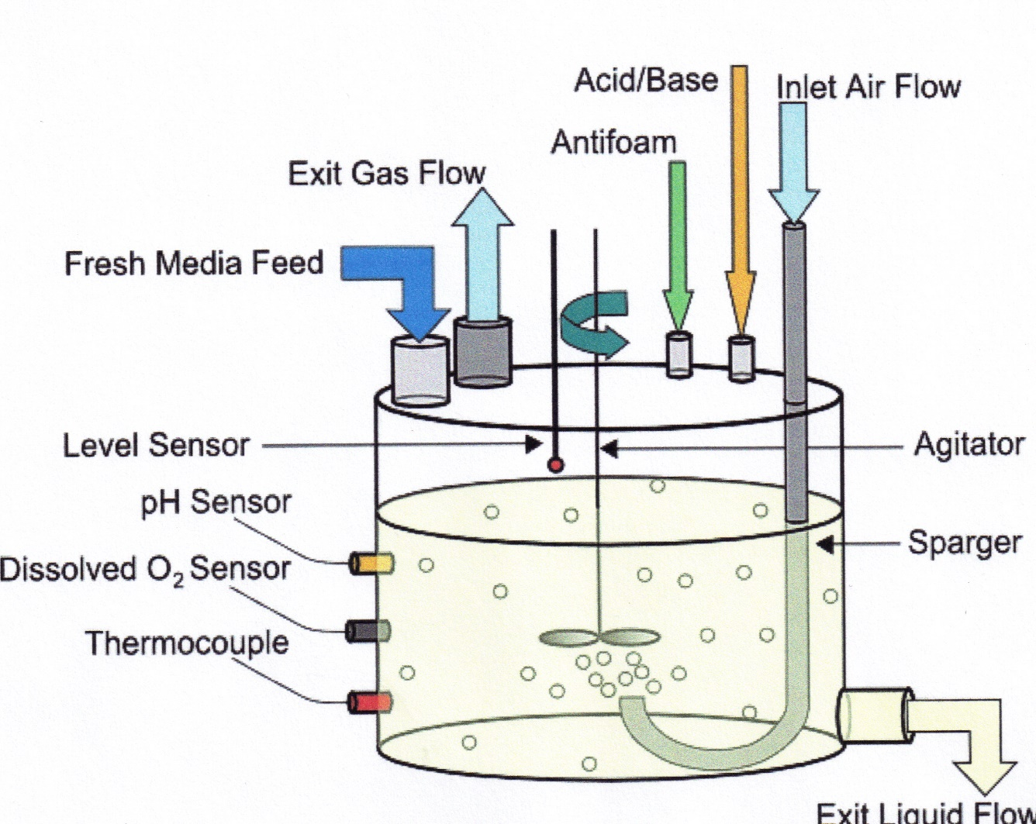
Continuous fermenter system

Slide 22
Important factors for continuous fermentation
The system must be stable for at least 500 hours.
Maintaining sterile conditions for all period of fermentation time.
The composition of nutrients must be constant all the time.
Maintaining the strain stability for constant high production yield (concerning about reverse mutation).

Slide 23
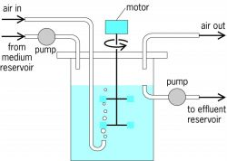
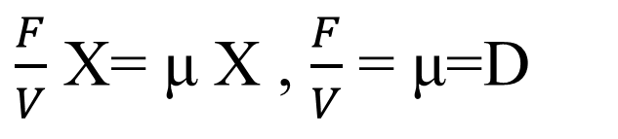
Batch Growth
F (l/h)
S_{o}(g/l)
X₀(g/l)
X (g/l)
S (g/l)
V= liquid volume
X= Cell concentration (g/L)
t=time
µ= specific growth rate (1/h)
Single stage chemostat
(Continuous culture)
S_{o} = Initial substrate concentration(g/l)
S = substrate concentration(g/l) at time t
q_{p}= Specific product formation rate (g-product/g -cell-hr)
m= Maintenance coefficient
Y= Yield coefficient
Material balance on cells
Cells in-Cells out+ Cell growth-Cell death= Cell Accumulation
α= Specific death rate
Assumptions:
X₀= sterile feed=0
Cell accumulation under steady state=0
α<< μ=0
0
0
0
$\frac{F}{V}$ X= μ X , $\frac{F}{V}$ = μ=D
D= DILUTION RATE

Slide 24
Material Balance in limiting nutrient
Nutrient in –Nutrient out-Nutrient consumed-Maintenance recruitmen
t-Product formation-Nutrient Accumulation

Slide 25
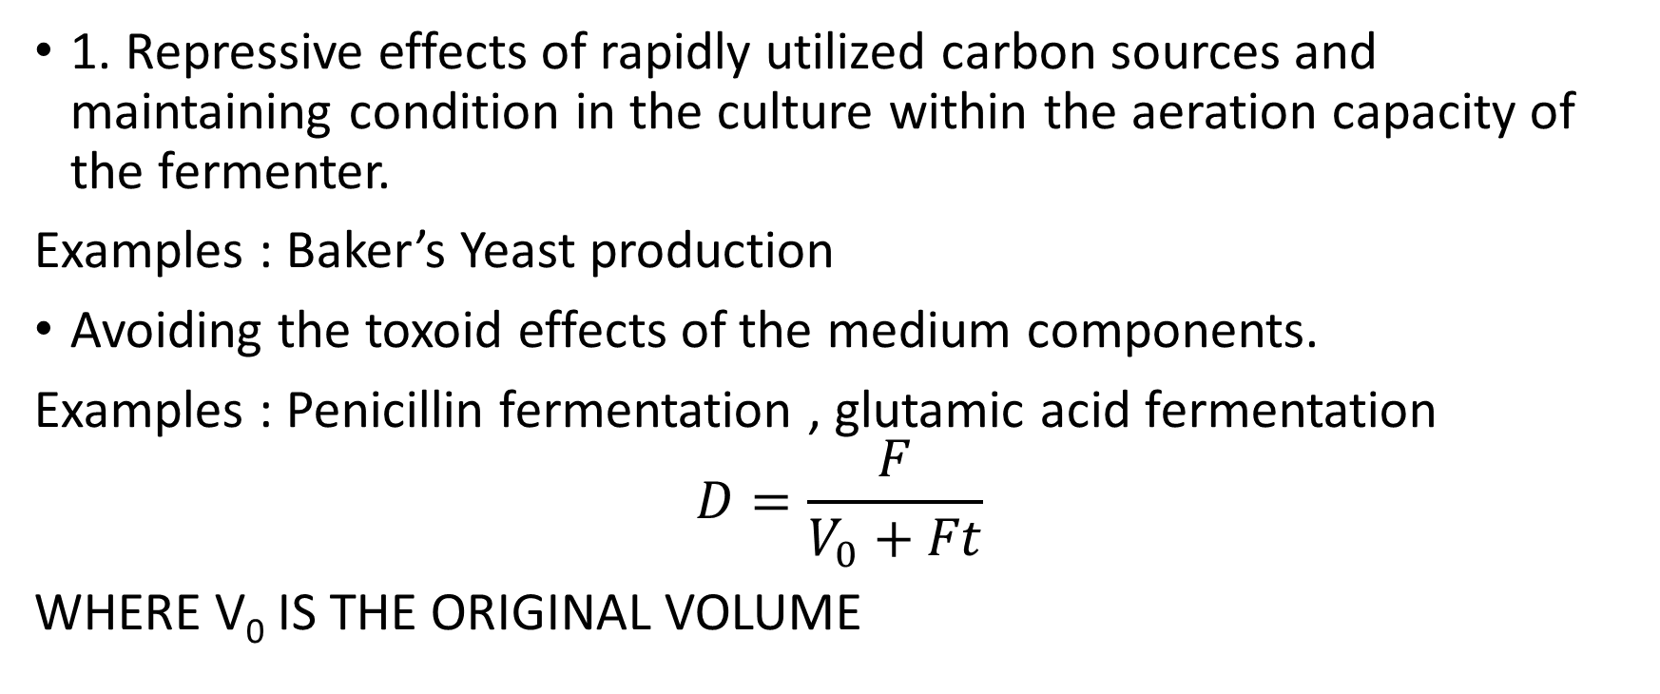
FED BATCH CULTURE
1. Repressive effects of rapidly utilized carbon sources and maintaining condition in the culture within the aeration capacity of the fermenter.
Examples : Baker’s Yeast production
Avoiding the toxoid effects of the medium components.
Examples : Penicillin fermentation , glutamic acid fermentation
$$D=\frac{F}{V_{0}+Ft}$$
WHERE V₀ IS THE ORIGINAL VOLUME

Slide 26
Sterilization
INTRODUCTION

Slide 27
A fermentation product is produced by the culture of a certain organism or organisms, in a nutrient medium.
If the fermentation is invaded by a foreign organism, it is said to be contaminated. This spoils the process.
One of the procedures to avoid contamination is to sterilize the medium, the fermenter vessel, & all other materials to be added to the fermentation during the process.

Slide 28
MEDIUM STERILIZATION
Media may be sterilized by filtration, radiation, ultrasonic treatment, chemical treatment or heat. However, for practical reasons, steam is used almost universally for the sterilization of fermentation media. (The major exception is the use of filtration for the sterilization of media for animal-cell culture - such media are completely soluble and contain heat labile components & so filtration is preferred.)

Slide 29
In the laboratory medium sterilization is usually done at 121 C for 15 to 20 min at 15 psig in an autoclave (pressure vessel)

Slide 30
Depending on the rate of heat transfer from steam, raising the temperature of the medium in large fermenters can take a significant period of time.
Once the holding or sterilisation temperature is reached, the temperature is held constant for a period of time t_{hd}.
Cooling is then done to reduce the medium temperature to the required value.
A typical temperature-time profile for batch sterilisation is shown in the figure.

Slide 31
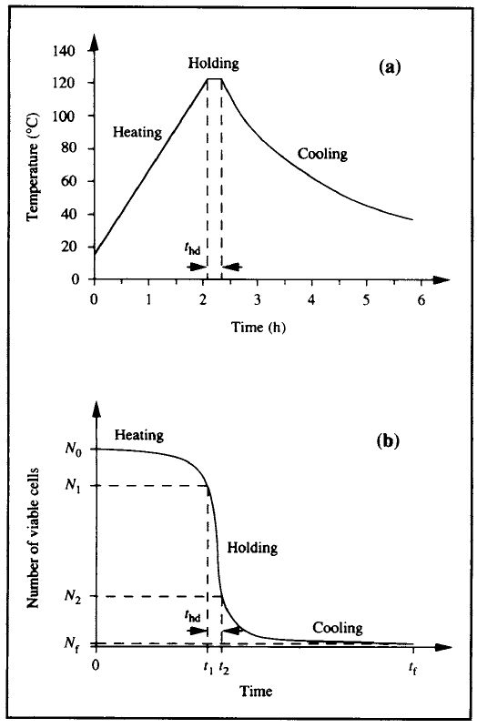
(a) Variation of temperature with time for
batch sterilisation of liquid medium. (b) Reduction in
number of viable cells during batch sterilisation.

Slide 32
Kinetics of Sterilization
The destruction of micro-organisms by steam (moist heat) may be described as a first-order chemical reaction and, thus, may be represented by the following equation:
-dN/dt = k_{d}N ............(1)
where
N is the number of viable organisms present,
t is the time of the sterilization treatment,
k_{d} is the reaction rate constant of the reaction,
or the specific death rate.

Slide 33
N.B.: Total number of organisms present in the volume of medium to be sterilized, not the concentration, is considered - minimum number of organisms to contaminate a batch is one, regardless of volume of batch.
Eq. (1) applies to each stage of the batch sterilisation cycle: heating, holding and cooling. However, because k_{d} is a strong function of temperature, direct integration of Eq. (1) is valid only when the temperature is constant, i.e. during the holding period.
On integration of equation (1), the following expression is obtained:
N_{t}/N_{o} = e^{-k}d^{t}hd, ................................................(2)
where
N_{o} is the number of viable organisms present at the start of the sterilization treatment,
N_{t} is the number of viable organisms present after a treatment period, t_{hd}.

Slide 34
k_{d} is evaluated as a function of temperature using the Arrhenius equation:
k_{d} = A e^{-E}d ^{/RT}
where A is the Arrhenius constant or frequency factor, E_{d} is the activation energy for the thermal cell death, R is the ideal gas constant and T is absolute temperature.

Slide 35
Taking natural logarithms, equation (2) is reduced to:
ln (N_{t}/N_{o}) = -k_{d}t_{hd}
This kinetic description makes two predictions which appear anomalous:
(i) An infinite time is required to achieve sterile
conditions (i.e. N_{t} = 0).
(ij) After a certain time there will be less than one viable cell present.
Thus, a value of N_{t} of less than one is considered in terms of the probability of an organism surviving the treatment. For example, if it were predicted that a particular treatment period reduced the population to 0.1 of a viable organism, this implies that the probability of one organism surviving the treatment is one in ten.

Slide 36
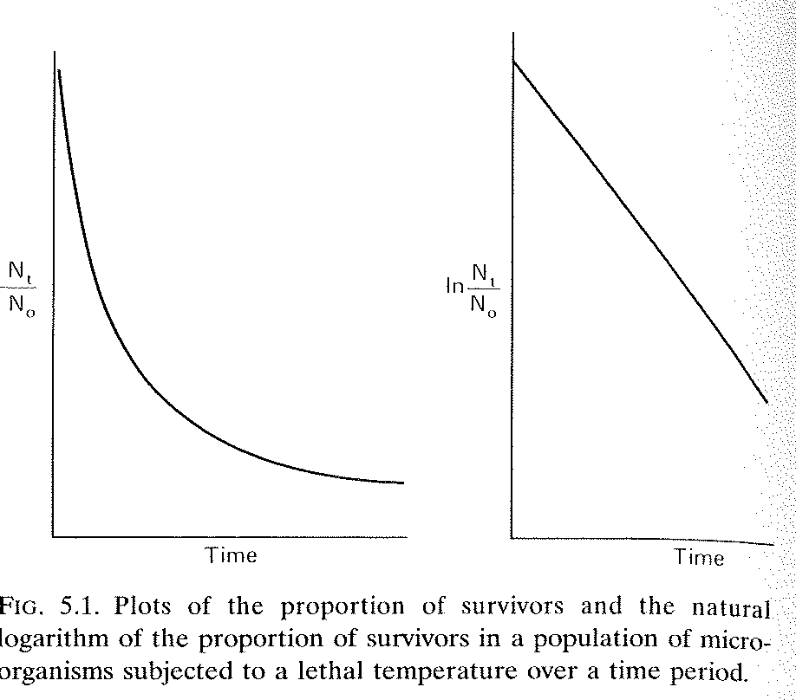

Slide 37
Decimal ReductionTime (D)
It is the time for the number of viable cells to reduce tenfold.
Hence substituting t_{hd} by D & N_{t}/N_{o} by 0.1 in the equation
N_{t}/N_{o} = e^{-k}d^{t}hd
we get 0.1 = e^{-k}d^{D}
& so, D = 2.303/k_{d}

Slide 38
ENZYMES
Enzymes are biocatalysts (functionally).
They are specific-catalyze specific reactions and specific to their substrate (i.e., reactant or molecule whose conversion is catalyzed by the enzyme).
Chemically all enzymes are proteins (except a small group of catalytic RNA molecules). Molecular weights - 12,000 to more than 1 million dalton.
Some enzymes require no chemical groups for activity other than their own amino acid residues. Some require additional chemical component.
Cofactors Coenzymes
One or more inorganic ions
Eg:-Fe²⁺, Mg²⁺, Mn²⁺, Zn²⁺
Complex organic or metalloorganic molecule. Eg:- coenzyme A

Slide 39
ENZYMES contn.
Some require both.
A coenzyme or metal ion (cofactor) that is very tightly or even covalently bound to the enzyme protein is called a prosthetic group
Complete, catalytically active enzyme together with its bound coenzyme and/or metal ions (cofactor) is called a holoenzyme.
Protein part of a holoenzyme is called apoenzyme or apoprotein.

Slide 40
How do enzymes work?
Provide a specific environment within which a given reaction can occur more rapidly, within a pocket on the enzyme called the active site.
Enzymes change only the rate of a reaction but not the chemical equilibrium
The reaction equilibrium is governed not by catalysts but by free energy difference between reactant (substrate) and product. Now this is usually expressed as standard free energy change (∆G⁰ defined at 298K, partial partial pressure of each gas 1 atm or 101.3 kilopascals (kPa), concentration of each solute 1M). However, biochemical systems commonly involve H⁺ concentration <<1M. Biochemists define a biochemical standard free energy change ∆G’⁰ at pH7 and water concentration≈ 55.5M.

Slide 41
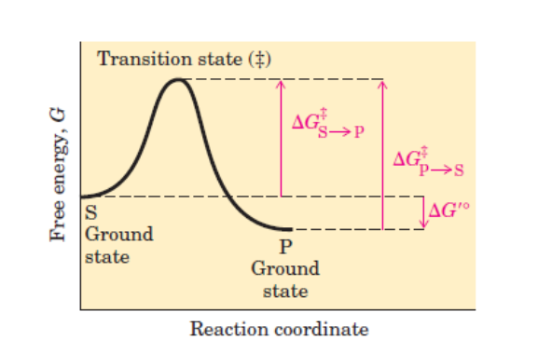
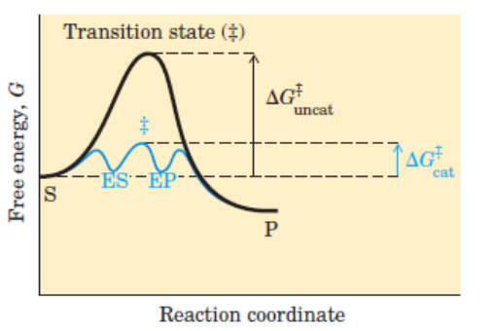
Consider a simple enzymatic reaction which might be written as:
ES & EP are transient complexes.
Equilibrium between S and P →∆G’⁰ for the ground states of S & P (P-S) is negative ie., favourable condition for reaction.

Slide 42
[But the rate depends on something else - Energy barrier between S and P-(Energy for alignment of reacting groups, formation of transient unstable charges, bond rearrangements etc. At the top of the energy hill is the transition state which is not a rate intermediate (such as ES or EP) – it is just a moment in which events such as bond breakage, bond formation, and charge development have proceeded to the precise point at which decay to either substrate or product is equally likely.]
Now reaction rate equation for reaction S→P is
v= k [S] . Where k is the reaction rate constant.
From the transition state theory
(where k is the Boltzmann constant & h is the Planck’s constant)
Thus lower the value of activation energy of the transition state, higher the rate constant. The role of an enzyme is to lower the activation energy of the transition state (from G‡(uncat) to G‡(cat)) as shown in the above figure.

Slide 43
Enzyme Kinetics.
Activity of an enzyme is the rate of the reaction it catalyses. This is given by:
v0- Number of moles of product formed per second ( or number of moles of substrate converted per sec.) i.e., +dp/dt (or – ds/dt)
Consider an enzyme that catalyzes S to P by the following pathway
At equilibrium there is no net change in concentration of S or P.
Enzyme kinetics is more easily dealt with if backward reaction from P to ES is ignored ie
In fact, the Michaelis-Menten model of kinetics of enzyme-catalyzed reactions is based on the above reaction model (with the backward reaction from P to ES ignored).
Hence v0 is defined at a time when [P] is very small i.e at time close to zero (hence v0) and when [S] >>[E]

Slide 44
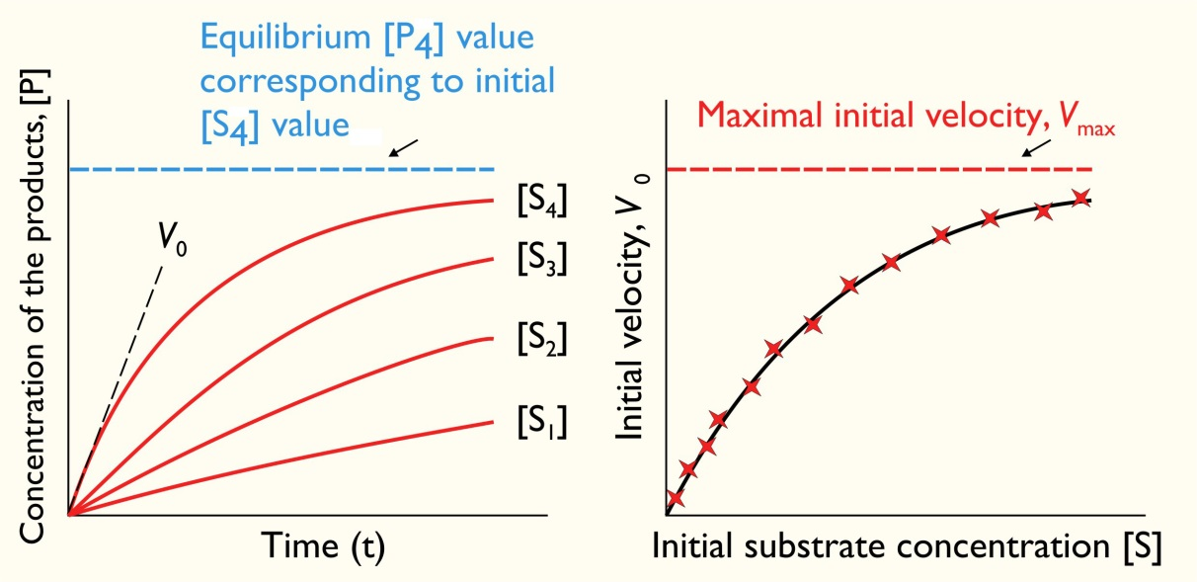

Slide 45
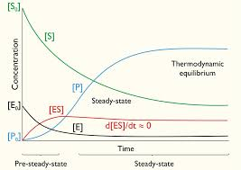

Slide 46
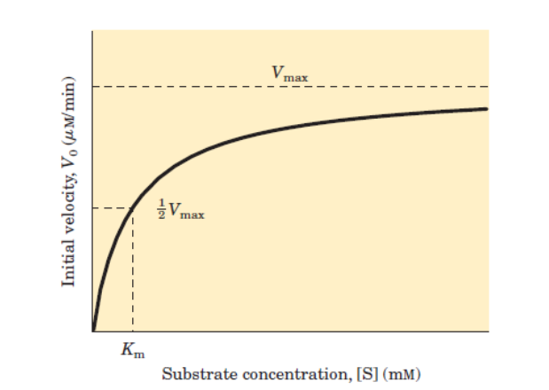
v_{max} is attained when the catalytic sites, i.e., active sites on the enzyme, are saturated with substrate.
The Michaelis-Menten model is thus
When [S]<<K_{m}, V₀=(V_{max}.[S]/K_{m}) (linear dependence on [S]) (i.e. 1st order rate eqn.)
When [S]>>K_{m}, V₀=V_{max} (independence of S) (i.e. zero order rate eqn.)
(Such a rate equation with different orders is called a reaction of shifting order.)
Km has two meanings :
I. Concentration of substrate at which half the active sites are filled i.e V₀=V_{max}/2
II. It is a measure of the strength of [ES] complex if K₂<< K ₋₁
High K_{m} →weak binding, low K_{m} →Strong binding

Slide 47
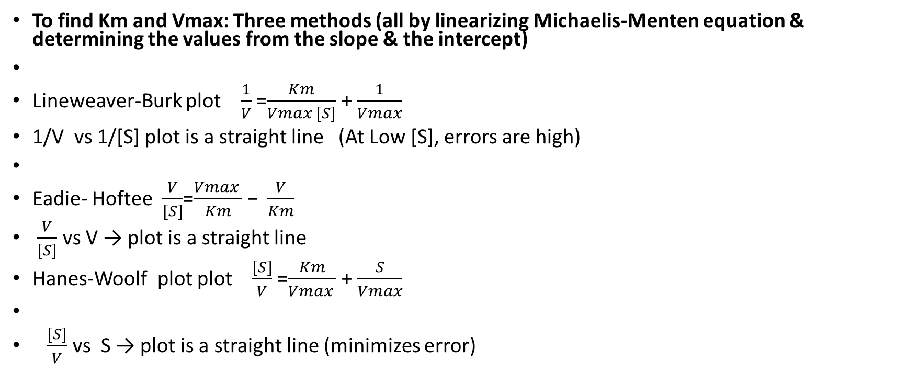
To find Km and Vmax: Three methods (all by linearizing Michaelis-Menten equation & determining the values from the slope & the intercept)
Lineweaver-Burk plot $\frac{1}{V}$ =$\frac{Km}{Vmax [S]}$ + $\frac{1}{Vmax}$
1/V vs 1/[S] plot is a straight line (At Low [S], errors are high)
Eadie- Hoftee $\frac{V}{[S]}$=$\frac{Vmax }{Km}$ −$\frac{V}{Km}$
$\frac{V}{[S]}$ vs V → plot is a straight line
Hanes-Woolf plot plot $\frac{[S]}{V}$ =$\frac{Km}{Vmax }$ + $\frac{S}{Vmax}$
$\frac{[S]}{V}$ vs S → plot is a straight line (minimizes error)

Slide 48
Enzymes Can Be Inhibited by Specific Molecules
The activity of many enzymes can be inhibited by the binding of specific small molecules and ions. Enzyme inhibition can be either reversible or irreversible. An irreversible inhibitor dissociates very slowly from its target enzyme because it has become tightly bound to the enzyme, either covalently or noncovalently.
Reversible inhibition, in contrast with irreversible inhibition, is characterized by a rapid dissociation of the enzymeinhibitor complex.

Slide 49
In competitive inhibition, an enzyme can bind substrate (forming an ES complex) or inhibitor (EI) but not both (ESI). The competitive inhibitor resembles the substrate and binds to the active site of the enzyme. The substrate is thereby prevented from binding to the same active site. A competitive inhibitor diminishes the rate of catalysis by reducing the proportion of enzyme molecules bound to a substrate. At any given inhibitor concentration, competitive inhibition can be relieved by increasing the substrate concentration. Under these conditions, the substrate "outcompetes" the inhibitor for the active site.
In noncompetitive inhibition, which also is reversible, the inhibitor and substrate can bind simultaneously to an enzyme molecule at different binding sites. Noncompetitive inhibition, in contrast with competitive inhibition, cannot be overcome by increasing the substrate concentration.

Slide 50
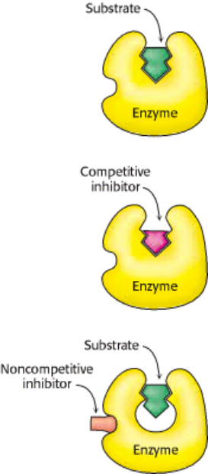
Distinction between a Competitive and a Noncompetitive Inhibitor. (Top) enzyme-substrate complex;
(middle) a competitive inhibitor binds at the active site and thus prevents the substrate from binding; (bottom) a non-competitive inhibitor does not prevent the substrate from binding.

